Slide 1
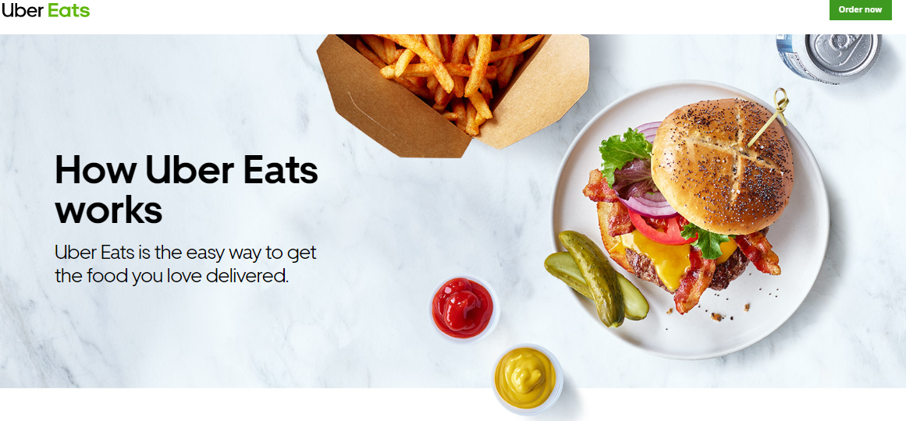
ISM6129 Group Project Report Uber Eats / Food Delivery System
Submitted:
Dec 08, 2022
By:
Sarah Alikhan, Clare Huang, Scarlet Wessin, Kirsten Hugh, Ruiying Zhu
Presentation Recording Hyperlink

Slide 2
Uber Eats / Food Delivery System
Project Idea:
We plan to model a food ordering system through a third-party app such as Uber Eats. In a food delivery system, there are typically four parties involved.
1. The person ordering 2. The delivery person 3. The restaurant where the order is placed 4. The app used to place the order
We will model the order placement and pickup process as a use case. In a food delivery system, the person first logs into the app to browse through the available restaurant options, chooses the restaurant they want to order from, decides on item(s) to order, and then reviews the details of their selection on the checkout page. On the checkout page, they will then set the tip amount, payment method, delivery address, order delivery time, and if there is a promotion they wish to apply to their order. Upon completing the process in the app, the involved restaurant is informed about the order details. Once the payment details are verified, the restaurant processes the order. Simultaneously, a delivery person is matched with the order and receives delivery instructions, picks it up from the restaurant (once the order is ready), and delivers it to the person who placed the order.
Motivation:
We are interested in modeling this system since we are all aware of the operations of such a system and the primary actors involved in it.

Slide 3
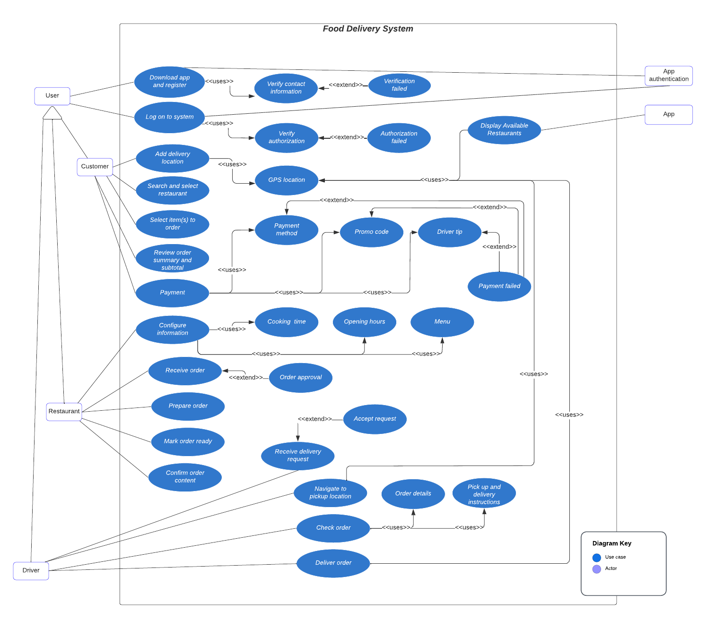
Use Case Diagram

Slide 4
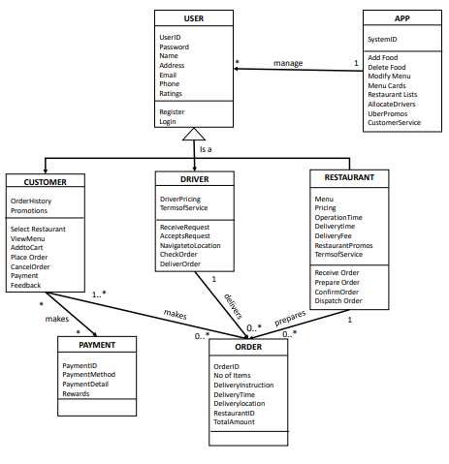
Class Diagram

Slide 5
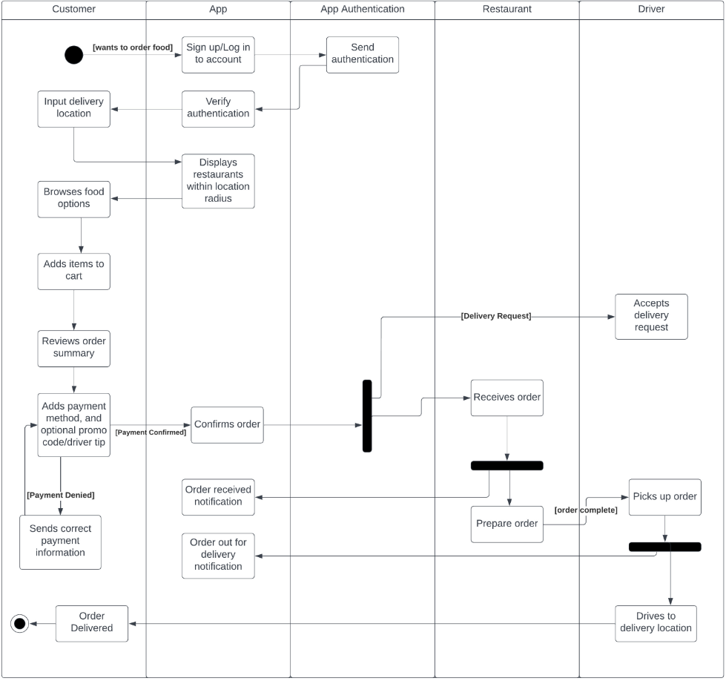
Activity Diagram

Slide 6
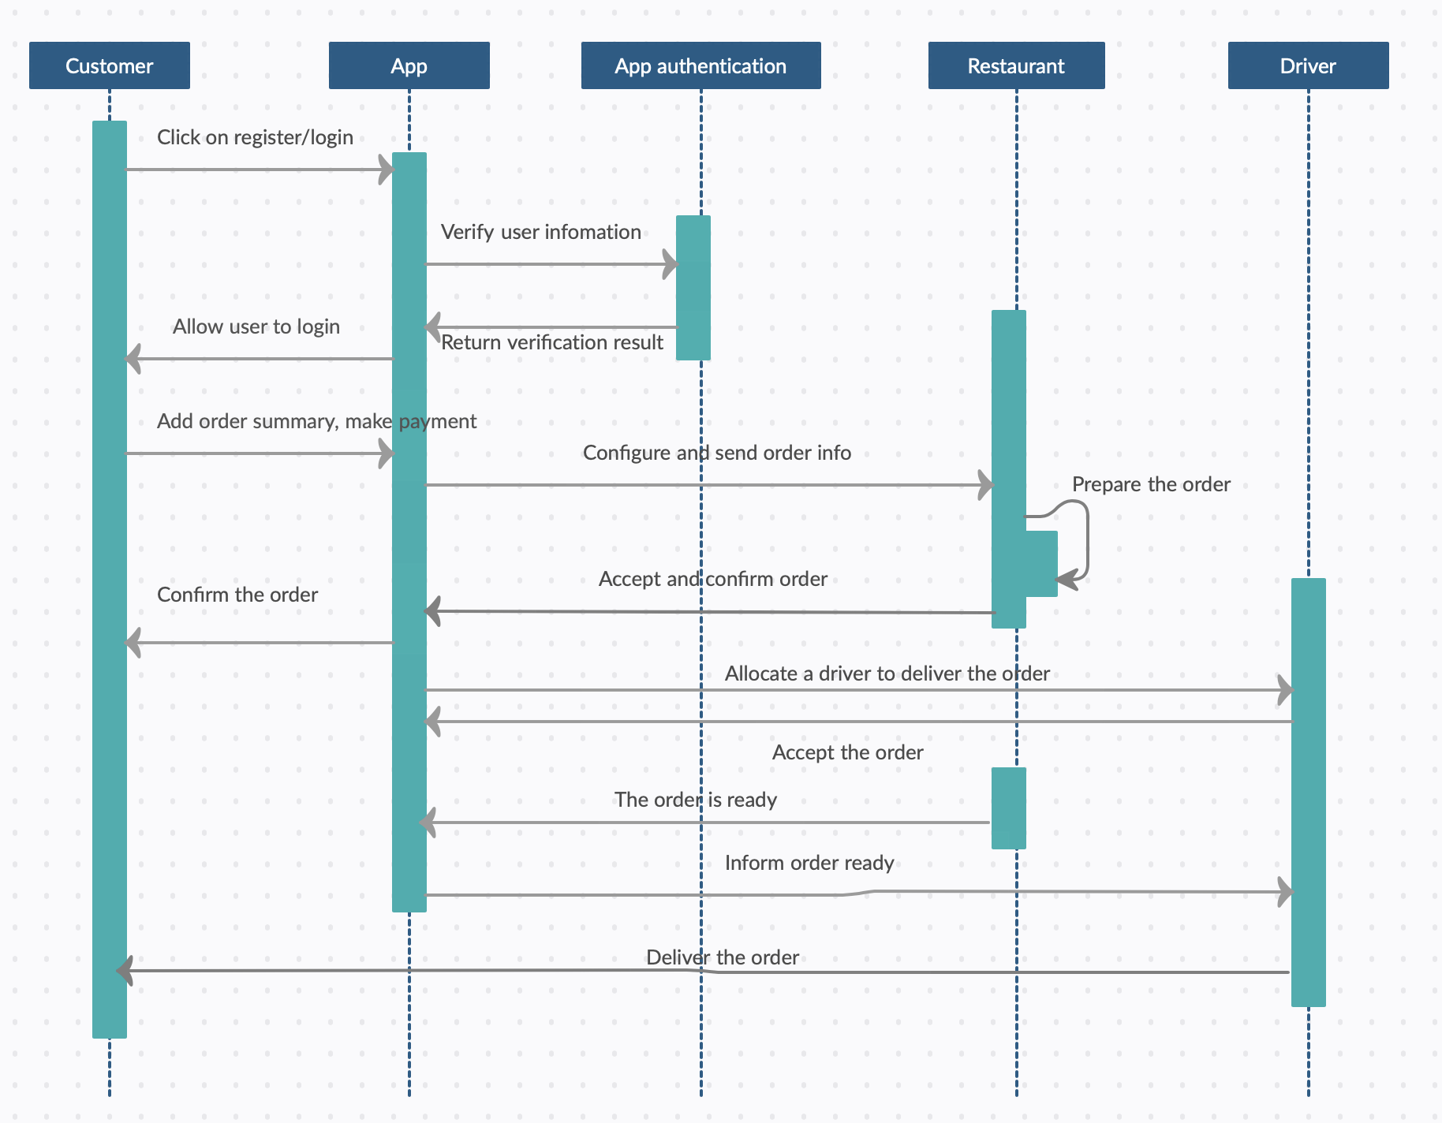
Sequence Diagram

Slide 7
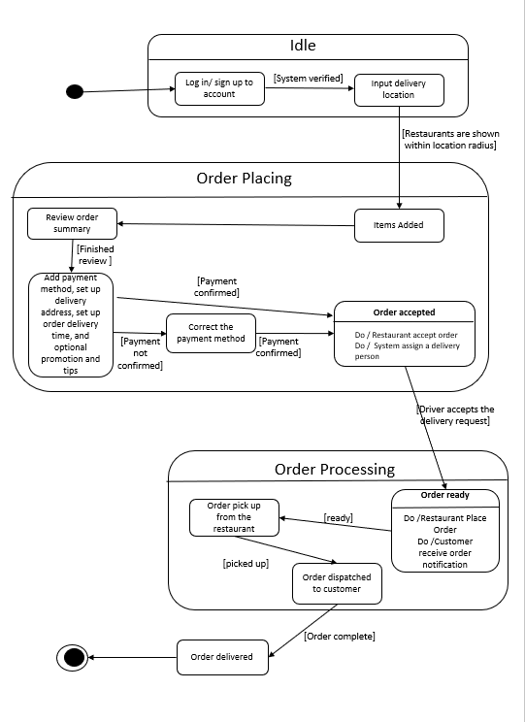
State Diagram

Slide 8
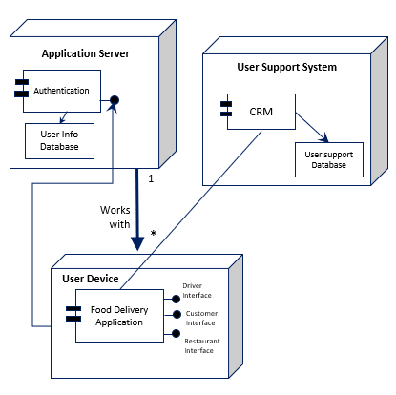
Component / Deployment Diagram

Slide 9
THANK YOU

